Slide 1
Hotel Management System

Slide 2
Prepared by:
Name
Muath Alhurtumi
Fahad Alghofaili
Saad Alshahrani
Ahmed Alshimshir
Mansour Alhenaki

Slide 3
Overview
Introduction
UML
Classes Description

Slide 4
Introduction
Hotel Reservation Management System
Two main users: Employee & Guest
Employee: manages hotel, adds/removes rooms
Guest: books, cancels, and checks out rooms
Check-out: saves booking in history.json
Stores: name, phone, nights stayed, total cost

Slide 5
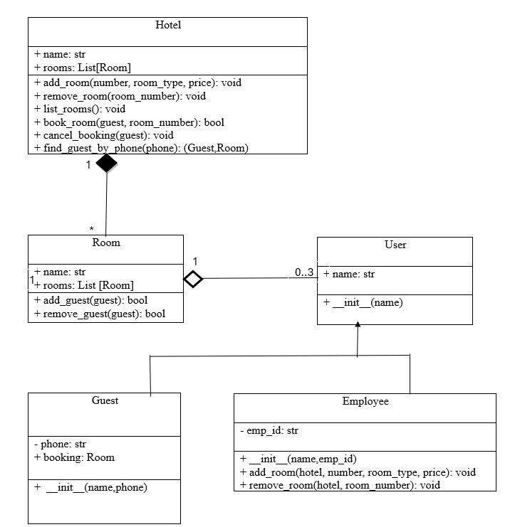
UML

Slide 6
Classes Description
Hotel
Attributes:
name, rooms list
Methods:
add_room, remove_room, list_rooms, book_room, cancel_booking, find_guest_by_phone

Slide 7
Classes Description
Room
Attributes:
number, type, price, status, guests
Methods:
add_guest, remove_guest

Slide 8
Classes Description
User, Guest, Employee
Attributes:
User: name
Guest: phone, booking
Employee: emp_id,
Methods:
__init__
Employee: add_room, remove_room

Slide 9
demo
https://dsaihotelmanagetwebiste-dctmejyuugsxmhchtfkpen.streamlit.app/

Slide 10
Thank you

